Slide 1
INSTAGRAM TOP-200 User analysis
ABISHEK K S
13-09-2023

Slide 2
SUMMARY
The analysis procedure is aimed to bring insights on the TOP-200 Instagram users
The dataset was obtained from Kaggle and is a relatively small dataset consisting of 200 Rows only.
The tech stack used is Power-BI, Openrefine (for Data Cleaning and faceting), SQLgate and Dbeaver for accessing MySQL(MariaDB) and Oracle databases.
Proof of working has also been attested within the report.

Slide 3
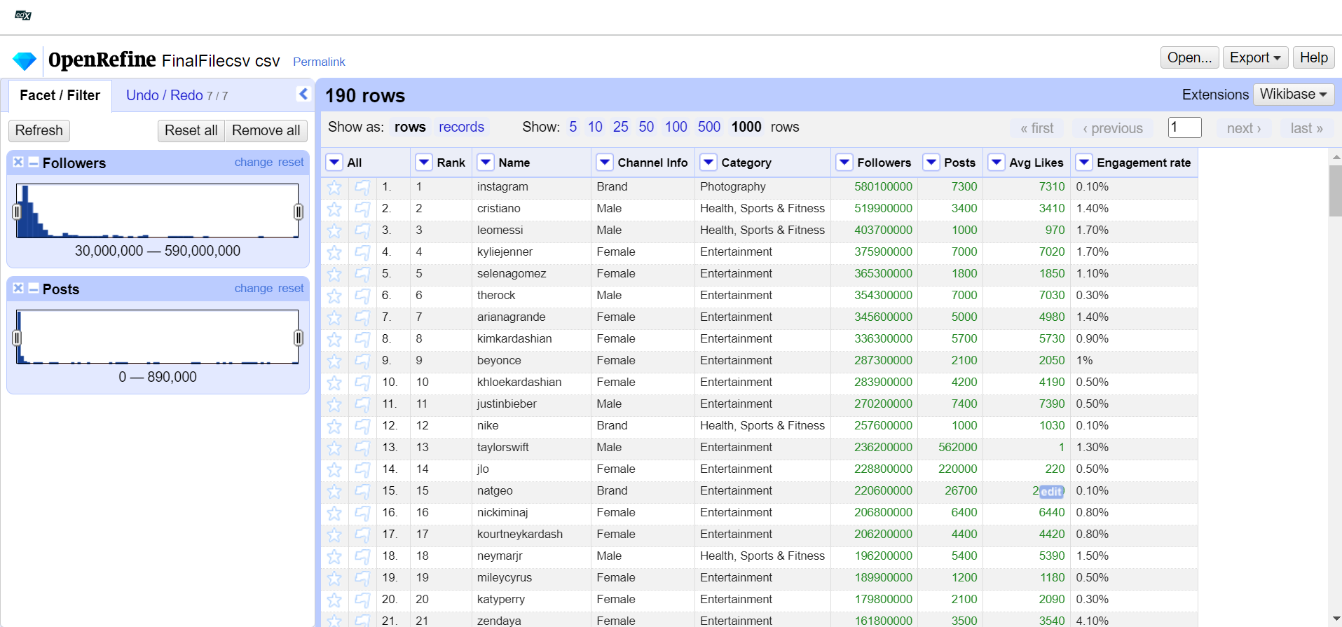
Open Refine – data cleaning and faceting

Slide 4
Open refine data cleaning
Open Refine was used to Clean the data. The following operations were performed :
1. Changing DT(Followers, Posts and Avg Likes) from Text to Numeric [ Numeric DT is indicated by the green color of text] using common transforms.
2. Observing facets/trends of followers and posts using In-Built numeric facet function.
3. Strings were properly formatted – ex: ‘b’ in ‘brands’ was changed to ‘B’.
4. ‘Category’ column strings were also properly formatted.

Slide 5
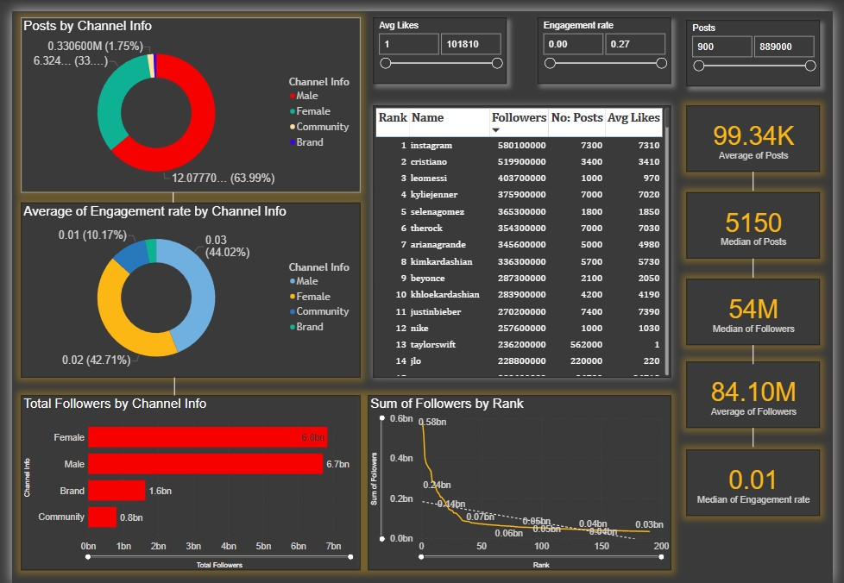
POWER BI DASHBOARD CREATION
Created a Power BI dashboard to carry out analysis.

Slide 6
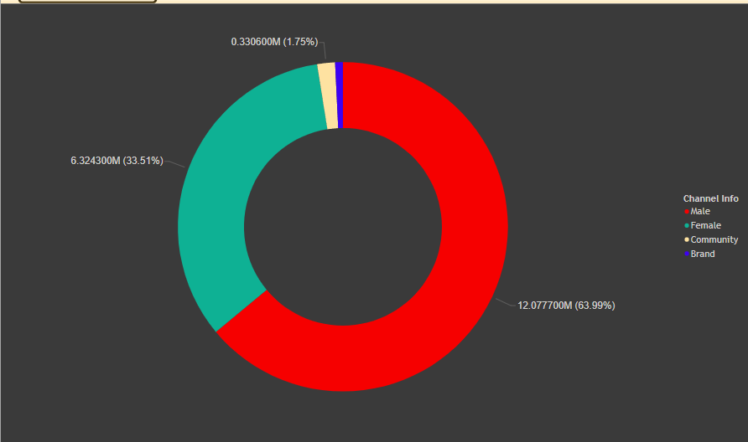
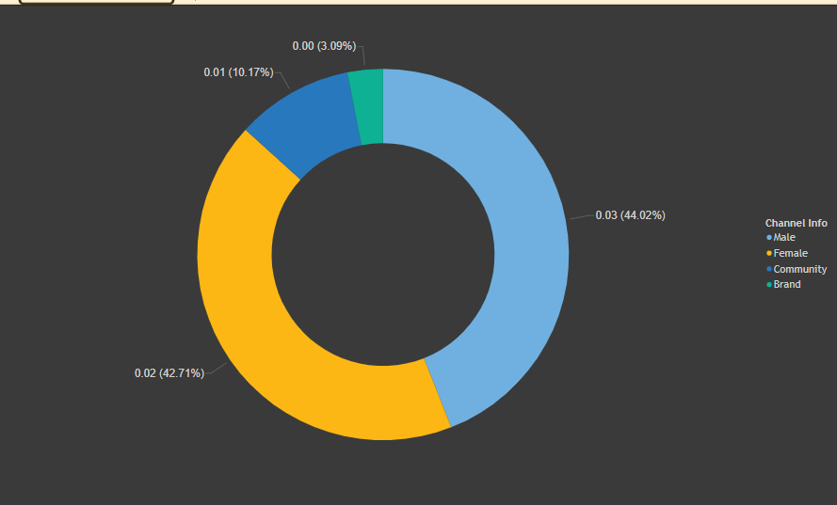
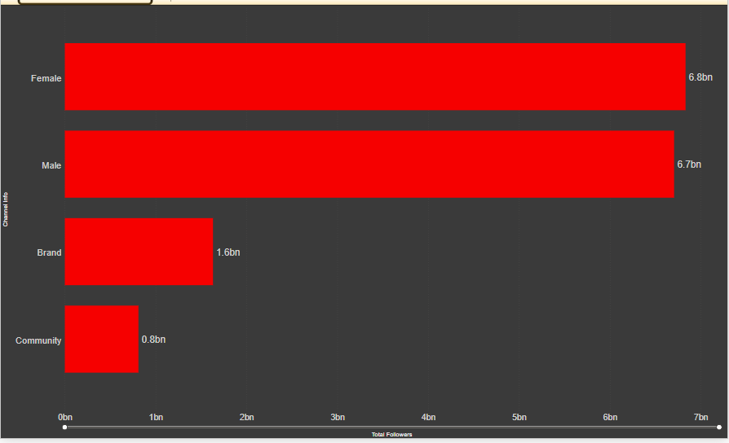
TRENDS
Male users in the top-200 list have the highest number of posts, followed by Females, Communities and brands in the 2nd ,3rd , and 4th positions respectively.
Male users have the highest engagement rate of 0.03, followed by females at 0.02 and Community pages at 0.01 respectively.
Females have the most number of followers at a total of 6.8 Billion, while males have a slightly lower cumulative follower count at 6.7 Billion.
Communities have the lowest total following, while brands are sandwiched between Males and Communities at 1.9 Billion.

Slide 7
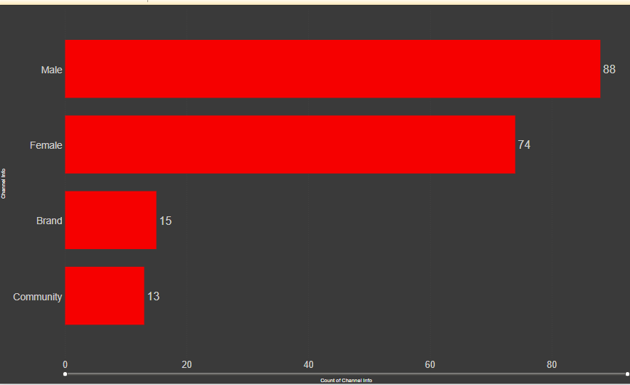
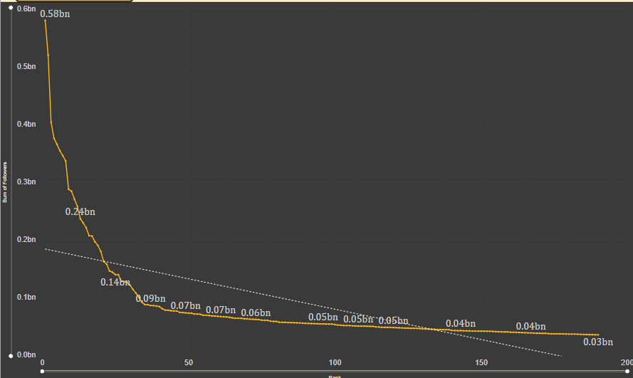
The distribution of the top 200 accounts are as follows :
1.Males – 88 accounts
2. Females- 74 accounts
3. Brands – 15 accounts
4. Communities – 13 accounts
The amount of followers follows an inverse-proportionality trend as seen from the Graph
The general trend of decrease is also seen.
Cristiano Ronaldo, Messi and The Rock are the top 3 followed Male influencers in the world.
Instagram has the most number of followers amongst brands, and Real Madrid, Barcelona and NASA have the most number of followers amongst communities.
Kylie Jenner, Selena Gomez Ariana Grande have the most number of followers in the female Category.

Slide 8
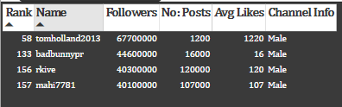
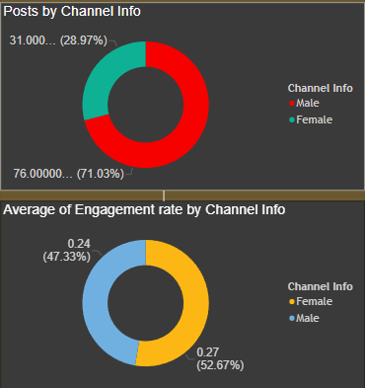
ENGAGEMENT RATE ANALYSIS
Engagement rate has been split into three ranks as a part of this analysis :
LER: Low Engagement rate [0.00 to 0.09] :
184 accounts have relatively low engagement rate in this range.
II. MER: Medium Engagement rate [0.09 to 0.18]:
Only 4 male accounts lie in this range.
III. HER: High Engagement Rate [0.18 to 0.27]:
A male account by the handle ‘thv’ has an
Avg ER of 0.24, followed by a female handle
‘j.m’ at the highest ER of 0.27.
IV. The male account still has the highest number of followers.

